Slide 1

Bhai Parmanand vidya mandir

Slide 2
Sub theme : Transport and communication

Slide 3
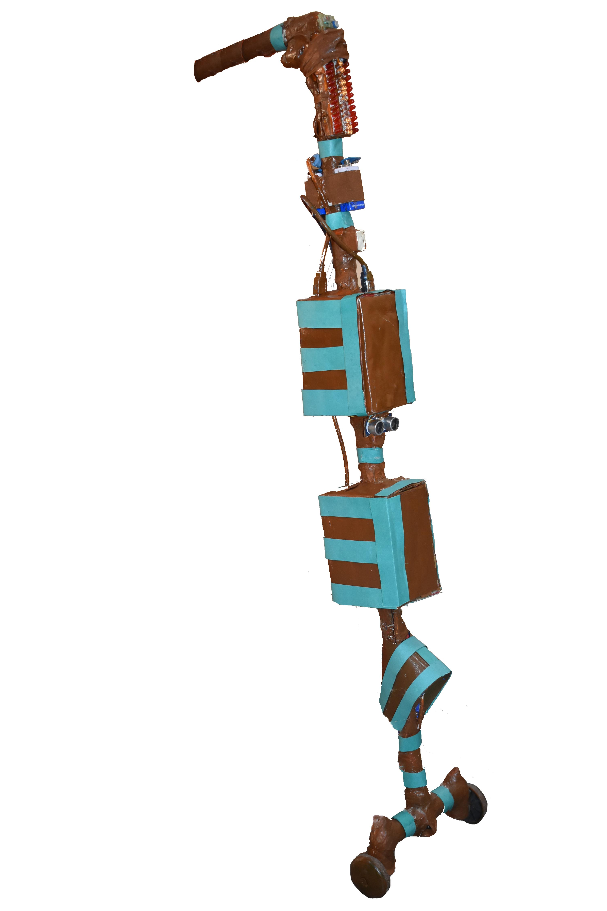
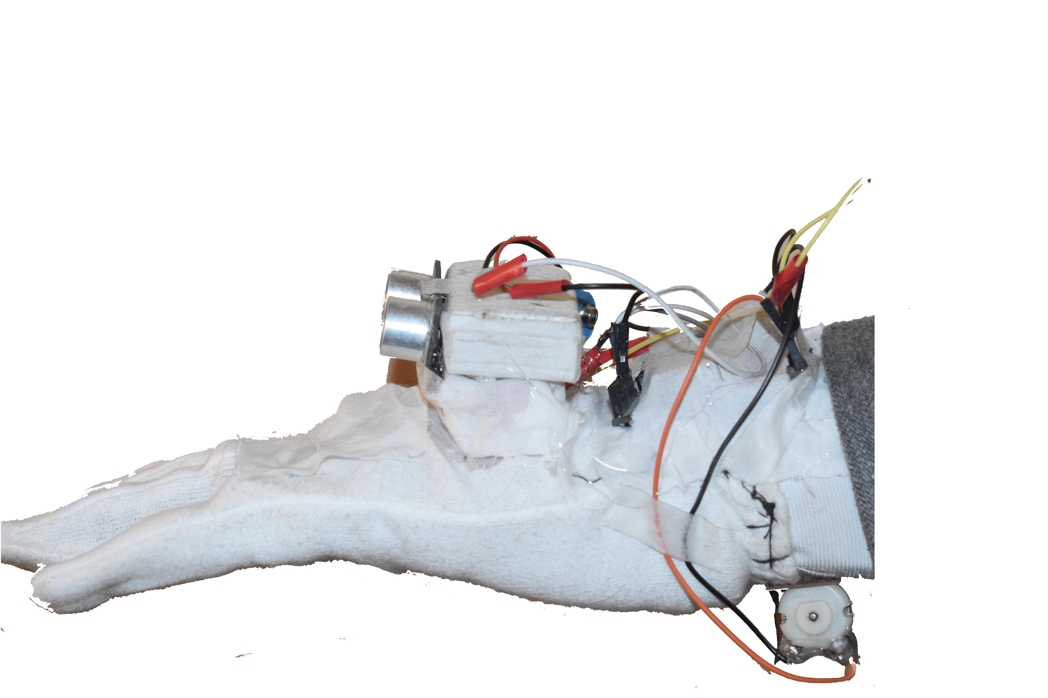
Blind’s Partner
BLIND’S STICK
BLIND’S GLOVE

Slide 4
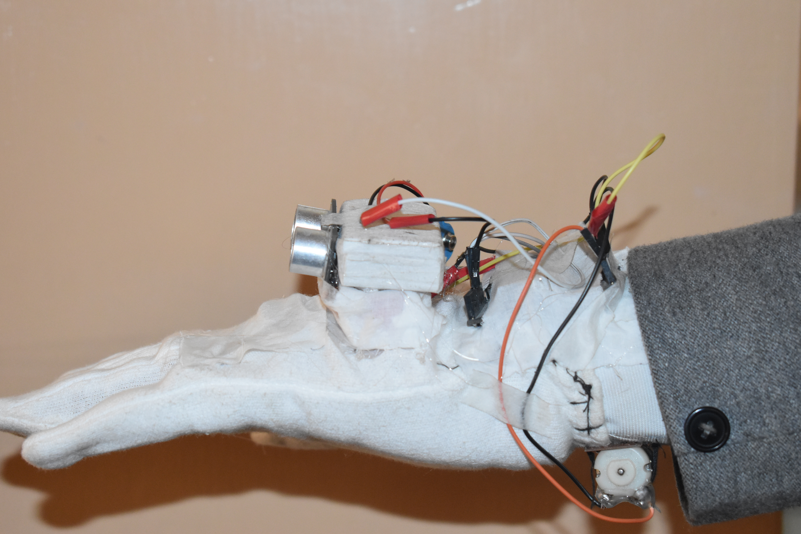
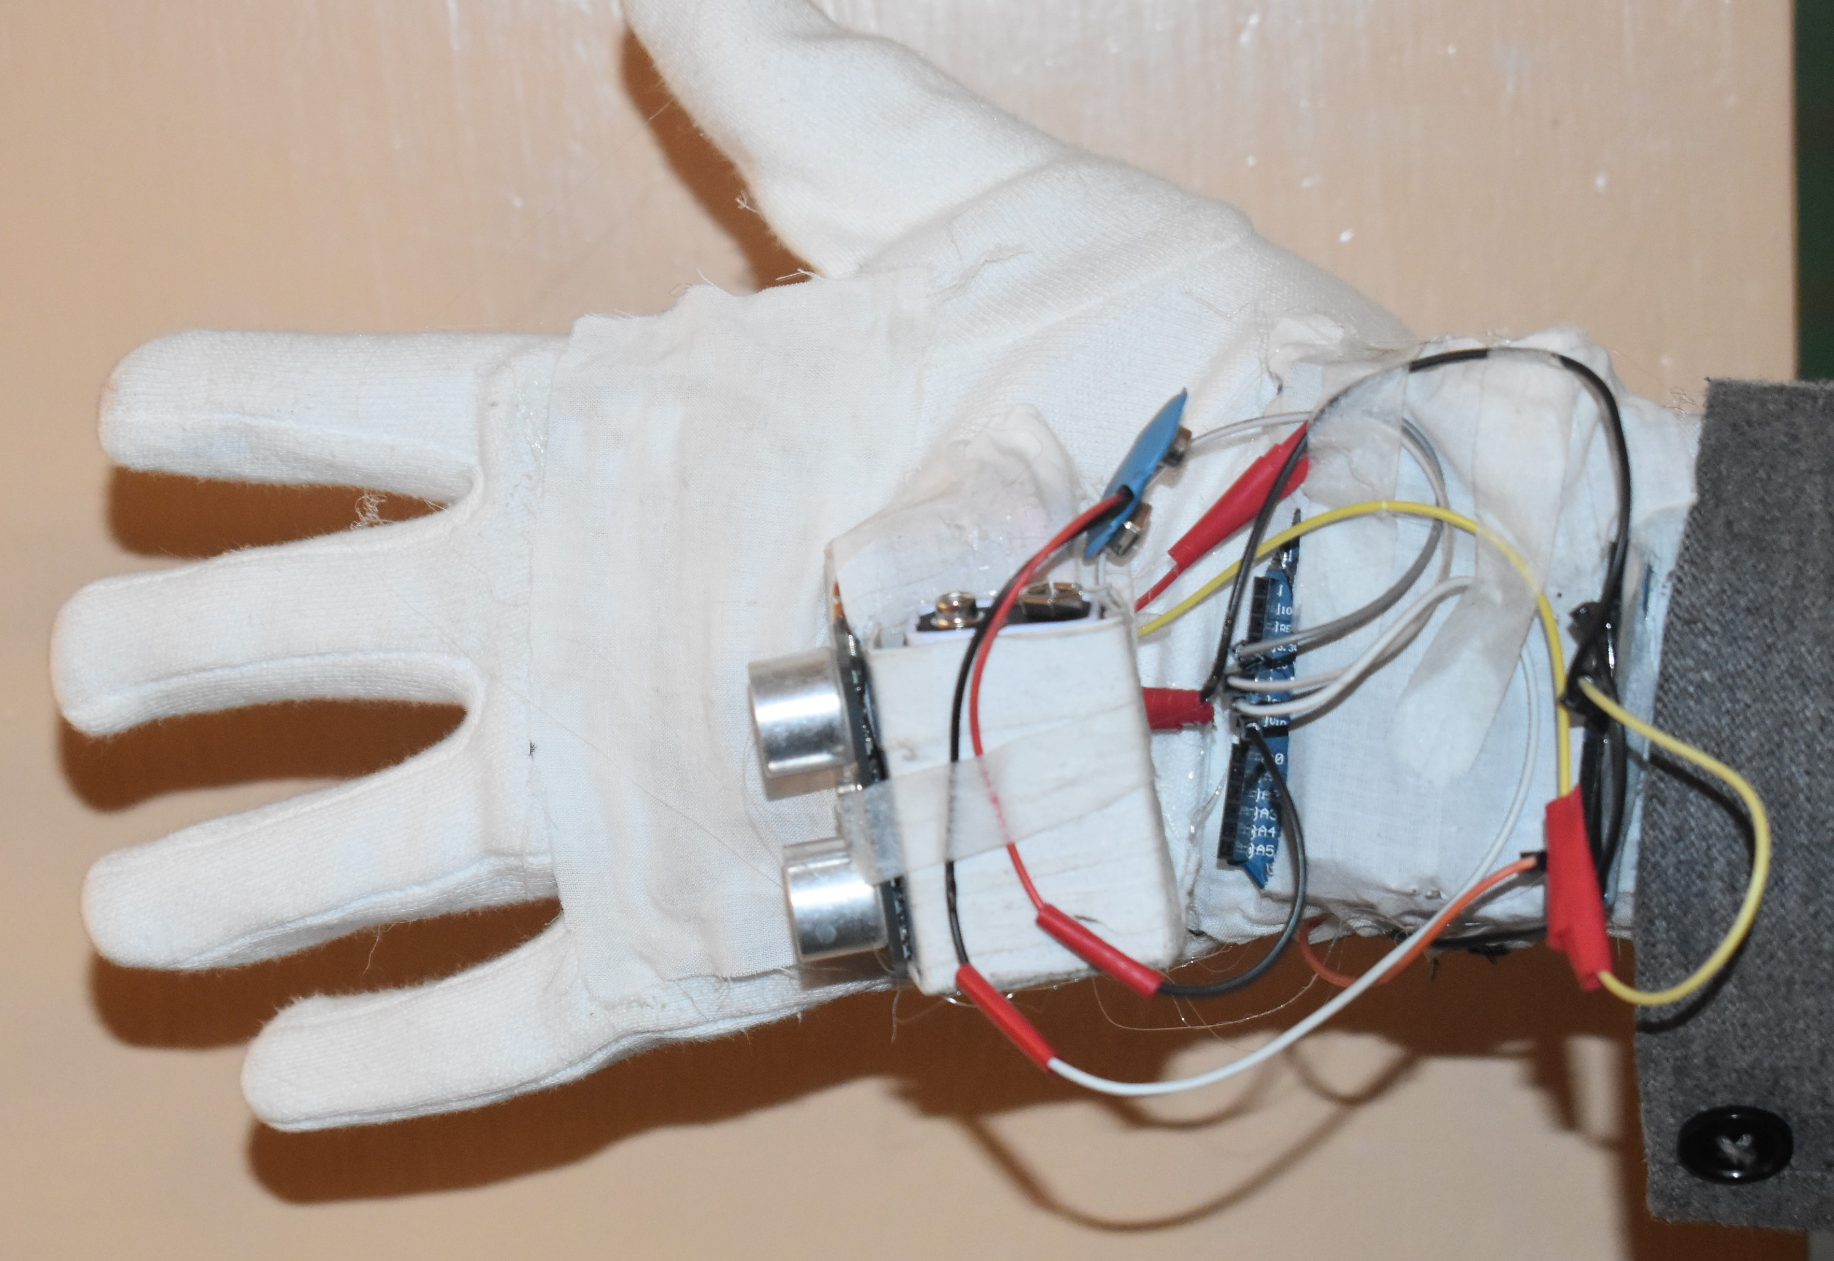
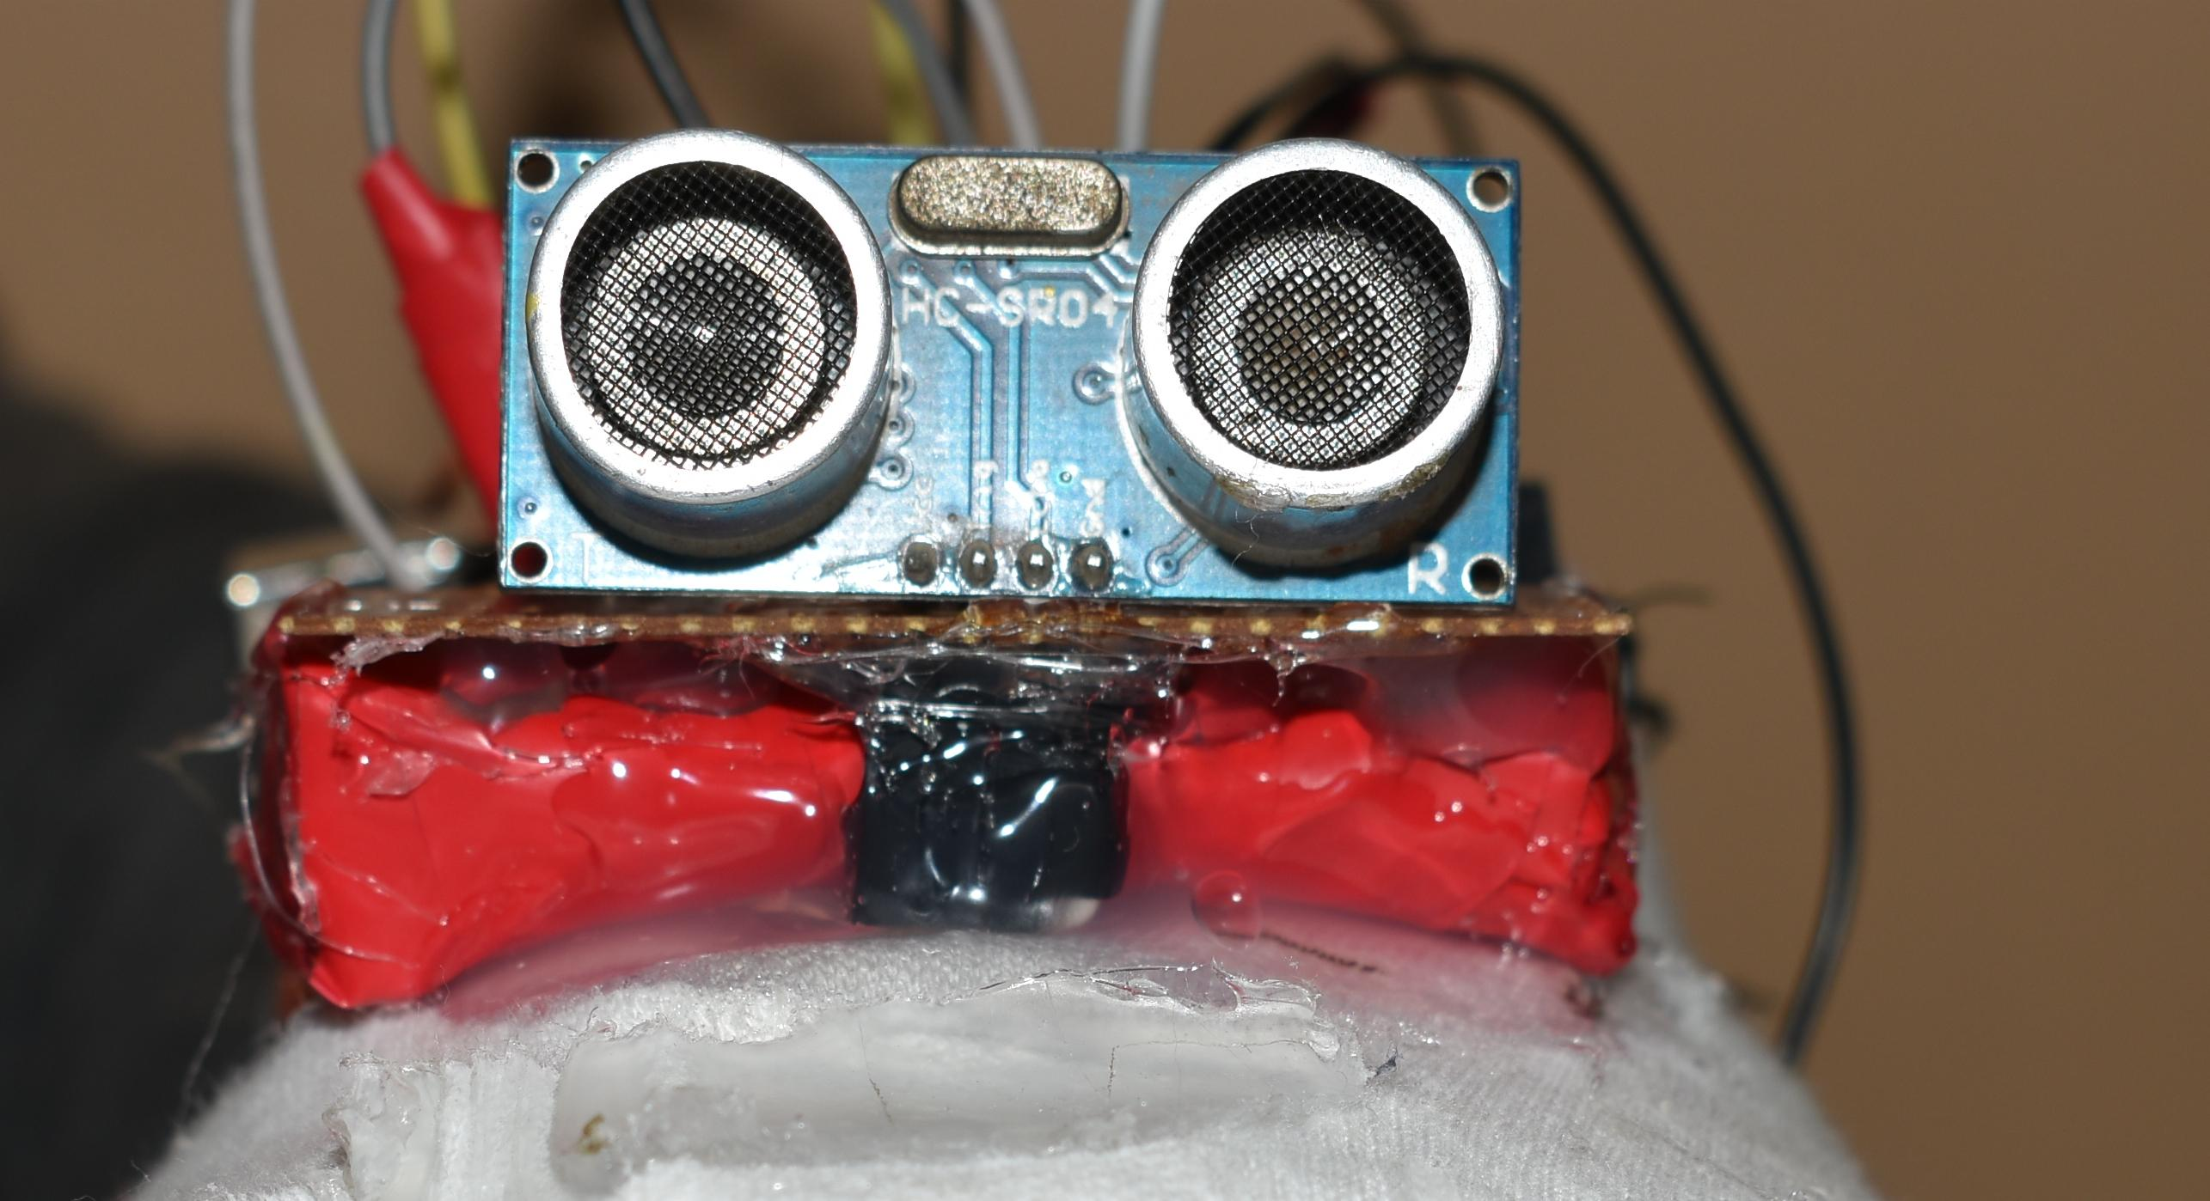
Blind’S glove
Here we have used a SONAR sensor withe the Arduino board if any object in range of 30cm comes in front of the blind person, then the hand starts vibrating because of a motor attatched. As we know that the person cannot move his stick in all directions easily, so this can be used as an alternative.

Slide 5
BLIND’S STICK
We have made this stick with an idea so that blind people can help themselves rather than taking help from others . We have added all the features that a blind person requires to fulfil his needs .

Slide 6
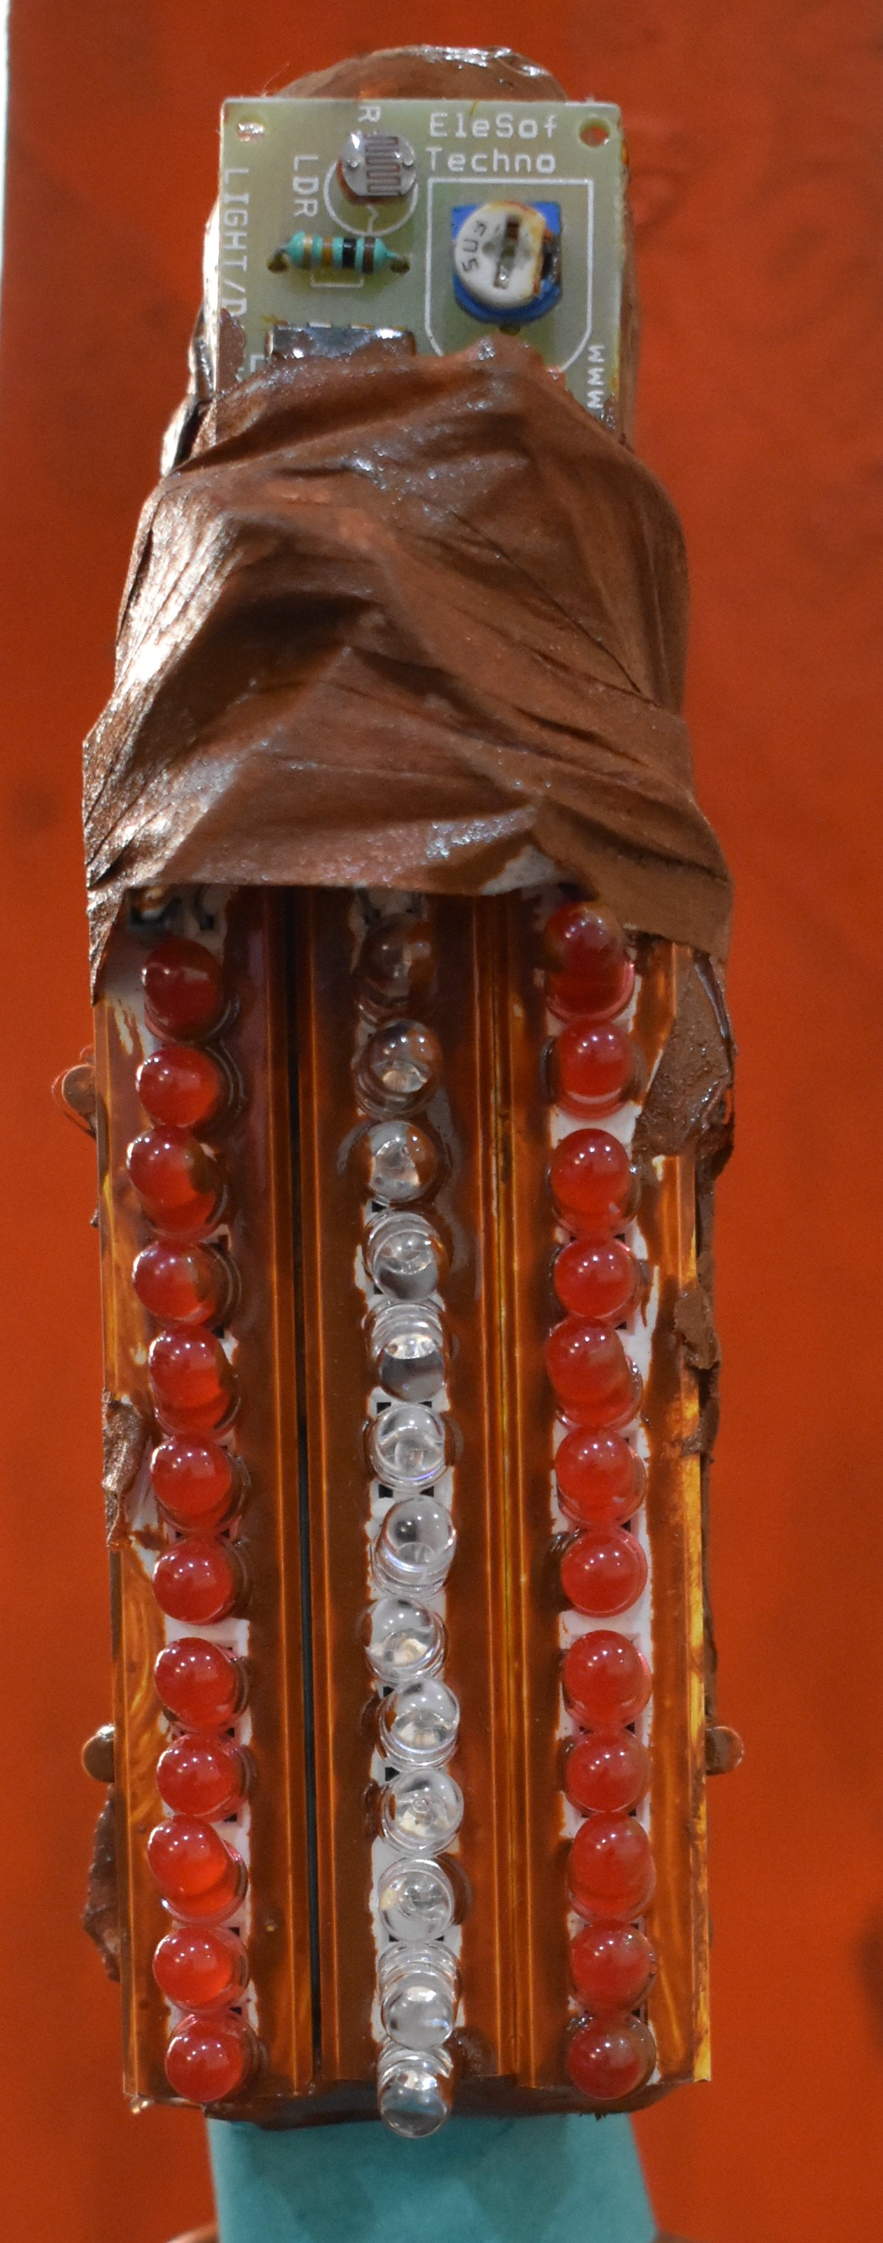
Ldr sensor – light dependent resistor
Here we have used a LDR sensor . It is a light detecting sensor. In normal day light the LED’s start glowing . It makes the blind person visible in night.

Slide 7
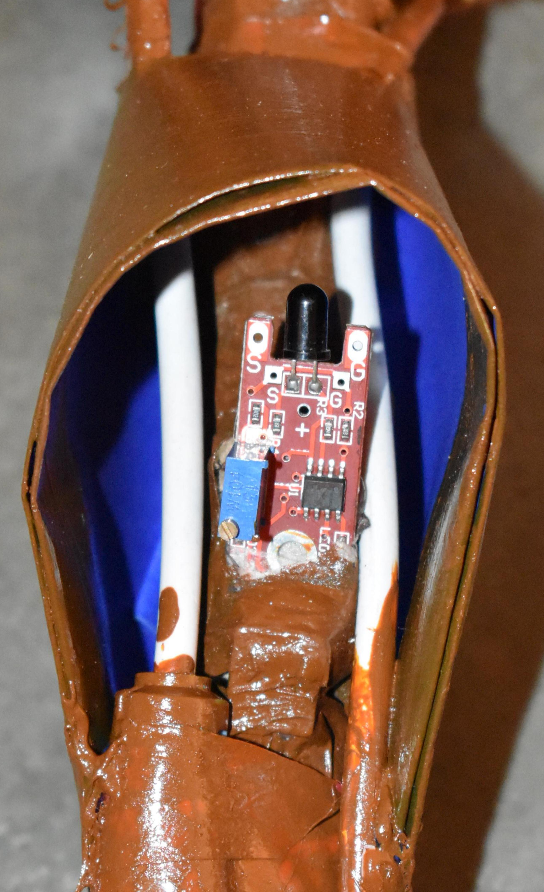
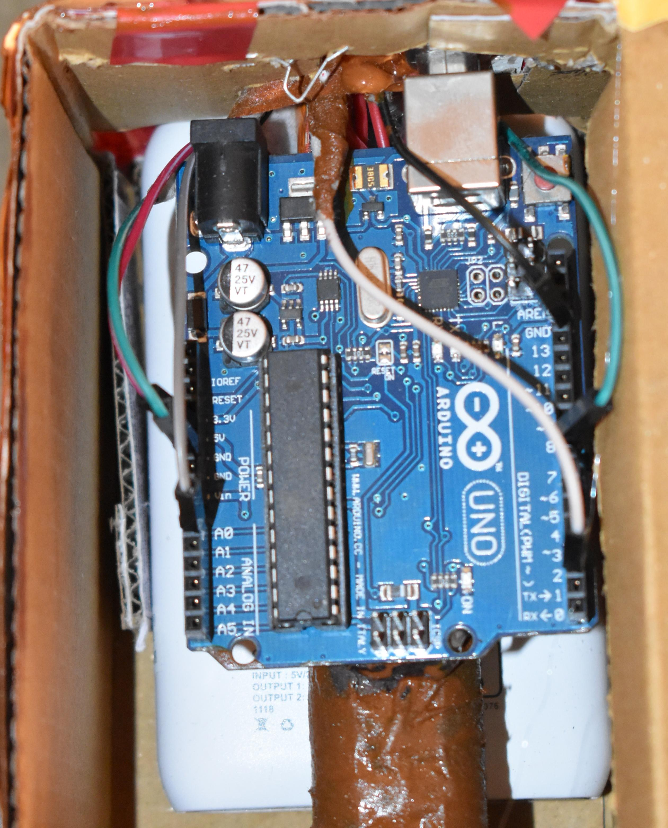
Flame sensor
Here we have used an Arduino board withw a flame sensor. Arduino board is a programmable board which can be programmed according to our will. The flame sensor detects fire and infrared lights . Even if the blind person has lost his stick somewhere in his room, he can press the button of remote and the buzzer will start beeping.

Slide 8
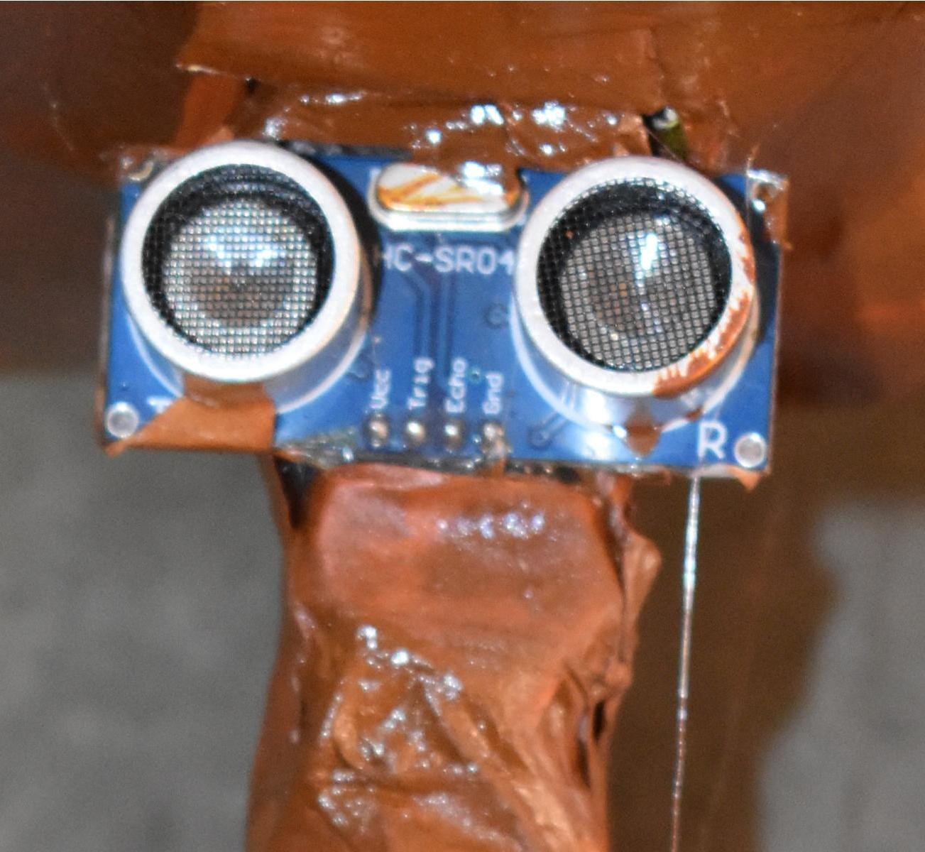
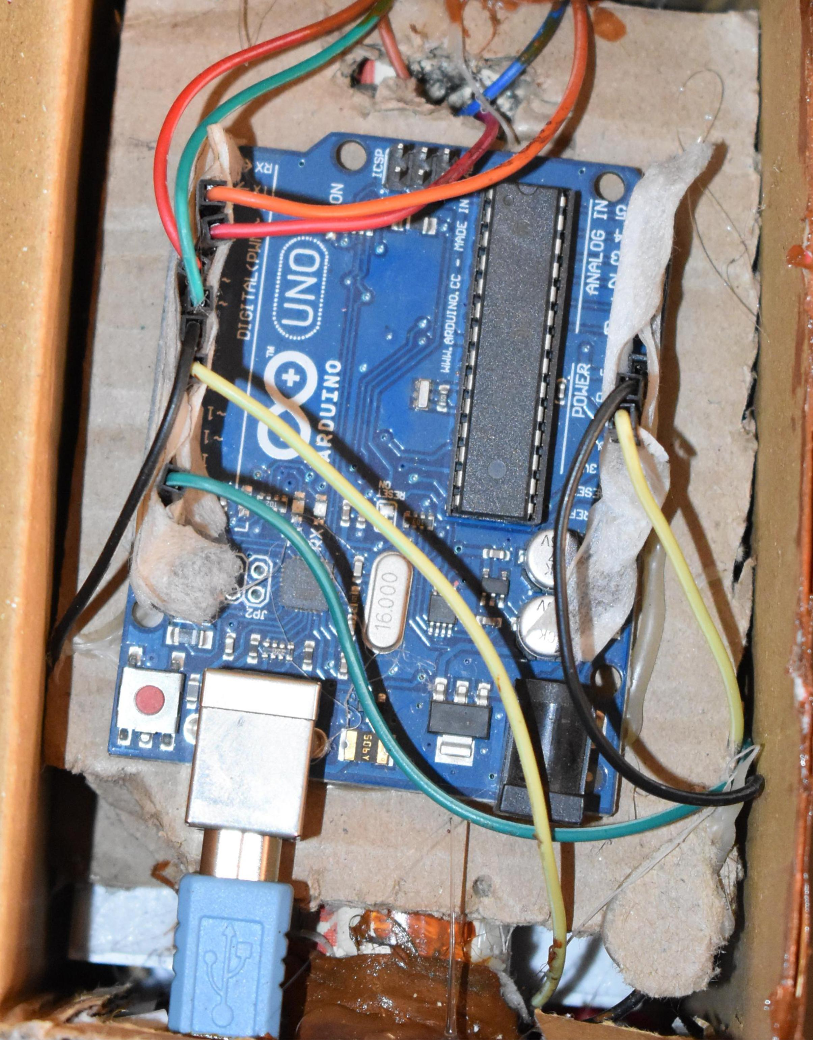
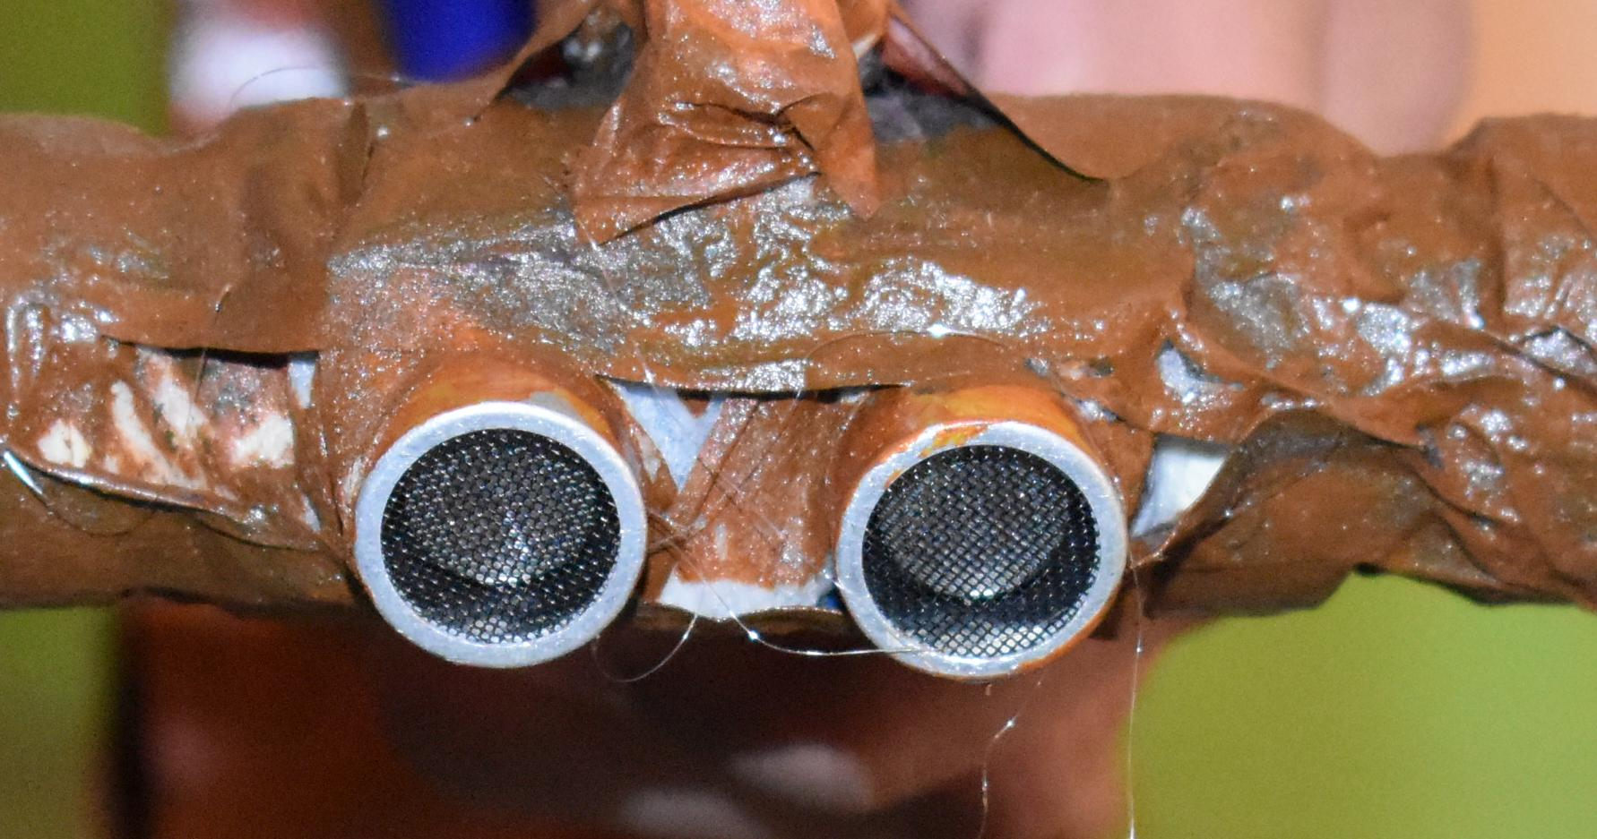
Sonar sensor – depth and distance
Here we have used two SONAR sensors with an Arduino board. If any object in the range of 60cm comes in front of the SONAR sensor then buzzer starts beeping. Also if there is a pit in front of blind person then the buzzer starts beeping loudly.

Slide 9
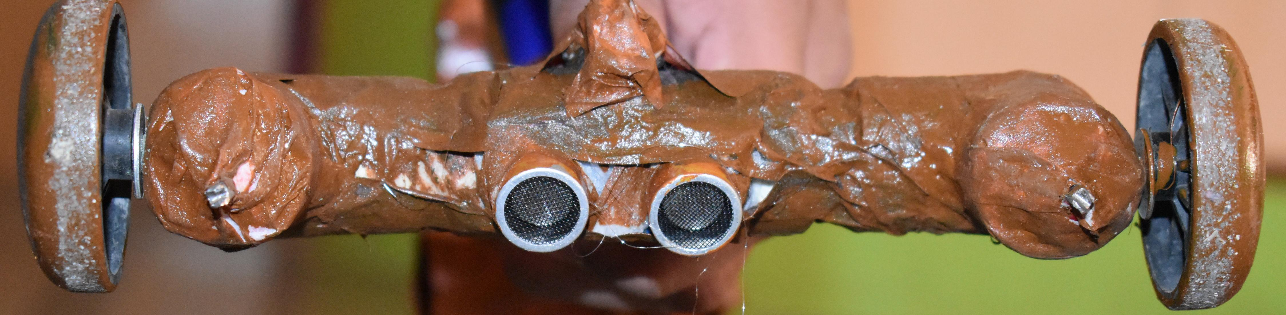
Electrodes
If there is water in the way of blind person then the stick starts vibrating because of a motor attached on the top of stick.

Slide 10
Name of participants
Vivek Prakash
Kartik Bhatia

Slide 11
THANK YOU
That was all about our project .

